Slide 1
Chapter 6: CPU Scheduling

Slide 2
Chapter 6: CPU Scheduling
Basic Concepts
Scheduling Criteria
Scheduling Algorithms
Thread Scheduling
Multiple-Processor Scheduling
Real-Time CPU Scheduling
Operating Systems Examples
Algorithm Evaluation

Slide 3
Objectives
To introduce CPU scheduling, which is the basis for multiprogrammed operating systems
To describe various CPU-scheduling algorithms
To discuss evaluation criteria for selecting a CPU-scheduling algorithm for a particular system
To examine the scheduling algorithms of several operating systems

Slide 4

Basic Concepts
Maximum CPU utilization obtained with multiprogramming
CPU–I/O Burst Cycle – Process execution consists of a cycle of CPU execution and I/O wait
CPU burst followed by I/O burst
CPU burst distribution is of main concern

Slide 5

Histogram of CPU-burst Times

Slide 6
CPU Scheduler
Short-term scheduler selects from among the processes in ready queue, and allocates the CPU to one of them
  Queue may be ordered in various ways
CPU scheduling decisions may take place when a process:
  1. Switches from running to waiting state
  2. Switches from running to ready state
  3. Switches from waiting to ready
  Terminates
Scheduling under 1 and 4 is nonpreemptive
All other scheduling is preemptive
  Consider access to shared data
  Consider preemption while in kernel mode
  Consider interrupts occurring during crucial OS activities

Slide 7
Dispatcher
Dispatcher module gives control of the CPU to the process selected by the short-term scheduler; this involves:
  switching context
  switching to user mode
  jumping to the proper location in the user program to restart that program
Dispatch latency – time it takes for the dispatcher to stop one process and start another running

Slide 8
Scheduling Criteria
CPU utilization – keep the CPU as busy as possible
Throughput – # of processes that complete their execution per time unit
Turnaround time – amount of time to execute a particular process
Waiting time – amount of time a process has been waiting in the ready queue
Response time – amount of time it takes from when a request was submitted until the first response is produced, not output (for time-sharing environment)

Slide 9
Scheduling Algorithm Optimization Criteria
Max CPU utilization
Max throughput
Min turnaround time
Min waiting time
Min response time

Slide 10
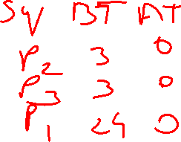

First- Come, First-Served (FCFS) Scheduling
Process Burst Time
P₁ 24
P₂ 3
P₃ 3
Suppose that the processes arrive in the order: P₁ , P₂ , P₃
The Gantt Chart for the schedule is:
Waiting time for P₁ = 0; P₂ = 24; P₃ = 27
Average waiting time: (0 + 24 + 27)/3 = 17

Slide 11

FCFS Scheduling (Cont.)
Suppose that the processes arrive in the order:
P₂ , P₃ , P₁
The Gantt chart for the schedule is:
Waiting time for P₁ = 6; P₂ = 0; P₃ = 3
Average waiting time: (6 + 0 + 3)/3 = 3
Much better than previous case
Convoy effect - short process behind long process
  Consider one CPU-bound and many I/O-bound processes

Slide 12
Shortest-Job-First (SJF) Scheduling
Associate with each process the length of its next CPU burst
  Use these lengths to schedule the process with the shortest time
SJF is optimal – gives minimum average waiting time for a given set of processes
  The difficulty is knowing the length of the next CPU request
  Could ask the user

Slide 13


Example of SJF
ProcessArriva l Time Burst Time
P₁ 0.0 6
P₂ 2.0 8
P₃ 4.0 7
P₄ 5.0 3
SJF scheduling chart
Average waiting time = (3 + 16 + 9 + 0) / 4 = 7

Slide 14
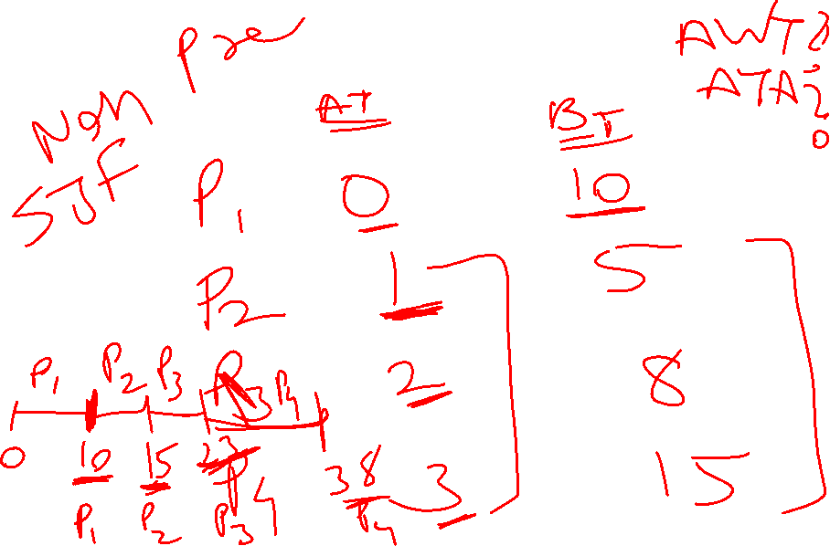


Slide 15
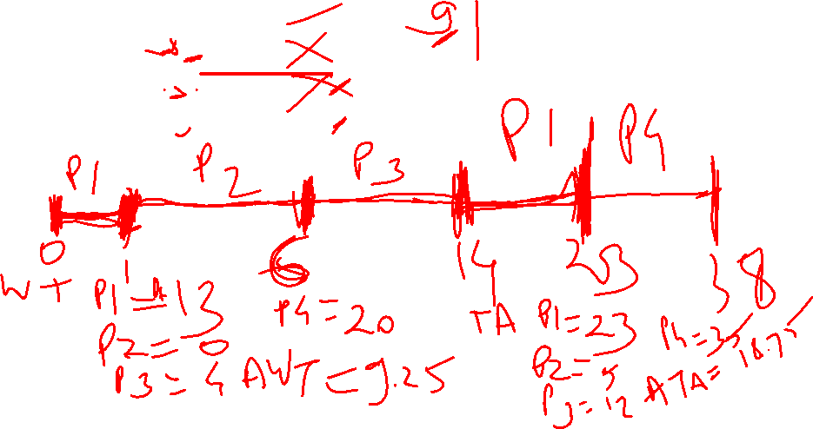
Pre-emptive SJF : Shortest Remaining Time Next(SRTN)
process | Arrival time | Burst time
p1 | 0 | 10
p2 | 1 | 5
p3 | 2 | 8
p4 | 3 | 15

Slide 16

Prediction of the Length of the Next CPU Burst

Slide 17
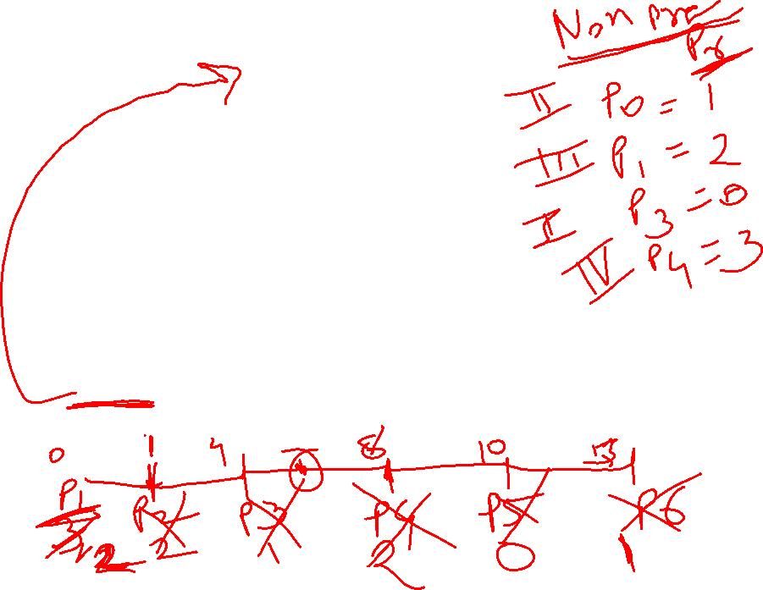
Priority Scheduling
A priority number (integer) is associated with each process
The CPU is allocated to the process with the highest priority (smallest integer ≡ highest priority)
  Preemptive
  Nonpreemptive
SJF is priority scheduling where priority is the inverse of predicted next CPU burst time
Problem ≡ Starvation – low priority processes may never execute
Solution ≡ Aging – as time progresses increase the priority of the process

Slide 18


Example of Priority Scheduling
ProcessA arri Burst TimeT Priority
P₁ 10 3
P₂ 1 1
P₃ 2 4
P₄ 1 5
P₅ 5 2
Priority scheduling Gantt Chart
Average waiting time = 8.2 msec
Non
pre-emptive

Slide 19

process | Arrival time | Burst time | Priority
p1 | 0 | 8 | 3
p2 | 1 | 1 | 1
p3 | 2 | 3 | 2
p4 | 3 | 2 | 3
p5 | 4 | 6 | 4
pre-emptive
p1 | p2 | p3 | p1 | p4 | p5
0 1 2 5 12 14 20
Notes:
TAT
P1=12
P2=1
P3=3
P4=11
P5=16
Waiting
P1=4
P2=0
P3=0
P4=9
P5=10

Slide 20
Round Robin (RR)
Each process gets a small unit of CPU time (time quantum q), usually 10-100 milliseconds. After this time has elapsed, the process is preempted and added to the end of the ready queue.
If there are n processes in the ready queue and the time quantum is q, then each process gets 1/n of the CPU time in chunks of at most q time units at once. No process waits more than (n-1)q time units.
Timer interrupts every quantum to schedule next process
Performance
  q large ⇒ FIFO
  q small ⇒ q must be large with respect to context switch, otherwise overhead is too high

Slide 21

Example of RR with Time Quantum = 4
Process Burst Time
P₁ 24
P₂ 3
P₃ 3
The Gantt chart is:
Typically, higher average turnaround than SJF, but better response
q should be large compared to context switch time
q usually 10ms to 100ms, context switch < 10 usec

Slide 22

Time Quantum and Context Switch Time

Slide 23

Turnaround Time Varies With The Time Quantum
80% of CPU bursts should be shorter than q

Slide 24
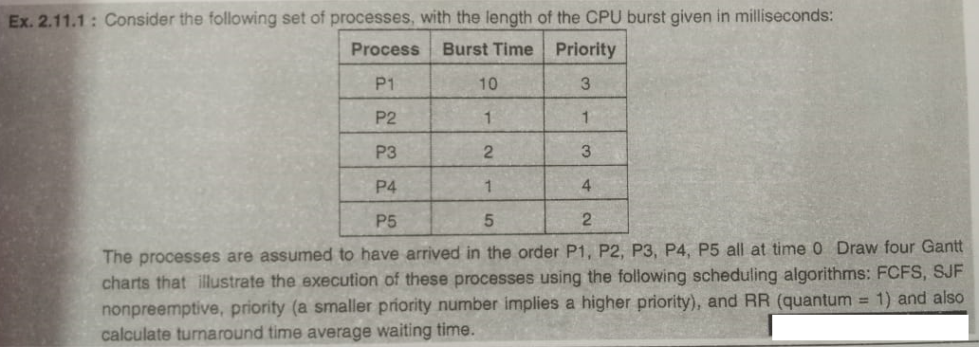

Slide 25
Multilevel Queue
Ready queue is partitioned into separate queues, eg:
  foreground (interactive)
  background (batch)
Process permanently in a given queue
Each queue has its own scheduling algorithm:
  foreground – RR
  background – FCFS
Scheduling must be done between the queues:
  Fixed priority scheduling; (i.e., serve all from foreground then from background). Possibility of starvation.
  Time slice – each queue gets a certain amount of CPU time which it can schedule amongst its processes; i.e., 80% to foreground in RR
  20% to background in FCFS

Slide 26

Multilevel Queue Scheduling

Slide 27
Multilevel Feedback Queue
A process can move between the various queues; aging can be implemented this way
Multilevel-feedback-queue scheduler defined by the following parameters:
  number of queues
  scheduling algorithms for each queue
  method used to determine when to upgrade a process
  method used to determine when to demote a process
  method used to determine which queue a process will enter when that process needs service

Slide 28

Example of Multilevel Feedback Queue
Three queues:
  Q₀ – RR with time quantum 8 milliseconds
  Q₁ – RR time quantum 16 milliseconds
  Q₂ – FCFS
Scheduling
  A new job enters queue Q₀ which is served FCFS
    When it gains CPU, job receives 8 milliseconds
    If it does not finish in 8 milliseconds, job is moved to queue Q₁
  At Q₁ job is again served FCFS and receives 16 additional milliseconds
    If it still does not complete, it is preempted and moved to queue Q₂

Slide 29

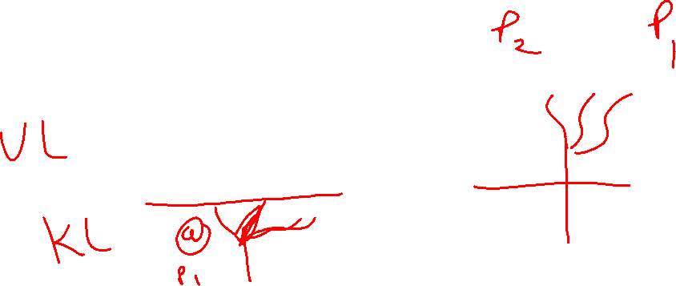
Thread Scheduling
Distinction between user-level and kernel-level threads
When threads supported, threads scheduled, not processes
Many-to-one and many-to-many models, thread library schedules user-level threads to run on LWP
  Known as process-contention scope (PCS) since scheduling competition is within the process
  Typically done via priority set by programmer
Kernel thread scheduled onto available CPU is system-contention scope (SCS) – competition among all threads in system

Slide 30
Multiple-Processor Scheduling
CPU scheduling more complex when multiple CPUs are available
Homogeneous processors within a multiprocessor
Asymmetric multiprocessing – only one processor accesses the system data structures, alleviating the need for data sharing
Symmetric multiprocessing (SMP) – each processor is self-scheduling, all processes in common ready queue, or each has its own private queue of ready processes
  Currently, most common
Processor affinity – process has affinity for processor on which it is currently running
  soft affinity
  hard affinity
  Variations including processor sets

Slide 31


Real-Time CPU Scheduling
Can present obvious challenges
Soft real-time systems – no guarantee as to when critical real-time process will be scheduled
Hard real-time systems – task must be serviced by its deadline
Two types of latencies affect performance
  Interrupt latency – time from arrival of interrupt to start of routine that services interrupt
  Dispatch latency – time for schedule to take current process off CPU and switch to another

Slide 32

Real-Time CPU Scheduling (Cont.)
Conflict phase of dispatch latency:
  Preemption of any process running in kernel mode
  Release by low-priority process of resources needed by high-priority processes

Slide 33

Priority-based Scheduling
For real-time scheduling, scheduler must support preemptive, priority-based scheduling
  But only guarantees soft real-time
For hard real-time must also provide ability to meet deadlines
Processes have new characteristics: periodic ones require CPU at constant intervals
  Has processing time t, deadline d, period p
  0 ≤ t ≤ d ≤ p
  Rate of periodic task is 1/p

Slide 34


Algorithm Evaluation
How to select CPU-scheduling algorithm for an OS?
Determine criteria, then evaluate algorithms
Deterministic modeling
  Type of analytic evaluation
  Takes a particular predetermined workload and defines the performance of each algorithm for that workload
Consider 5 processes arriving at time 0:

Slide 35



Deterministic Evaluation
For each algorithm, calculate minimum average waiting time
Simple and fast, but requires exact numbers for input, applies only to those inputs
  FCS is 28ms:
  Non-preemptive SFJ is 13ms:
  RR is 23ms:

